Slide 1
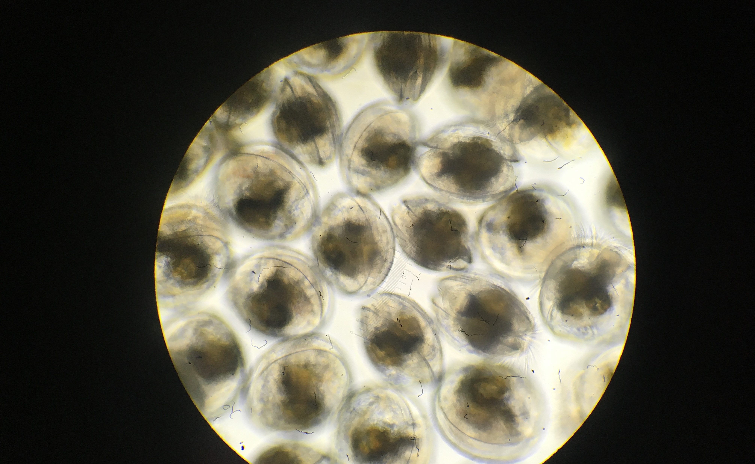
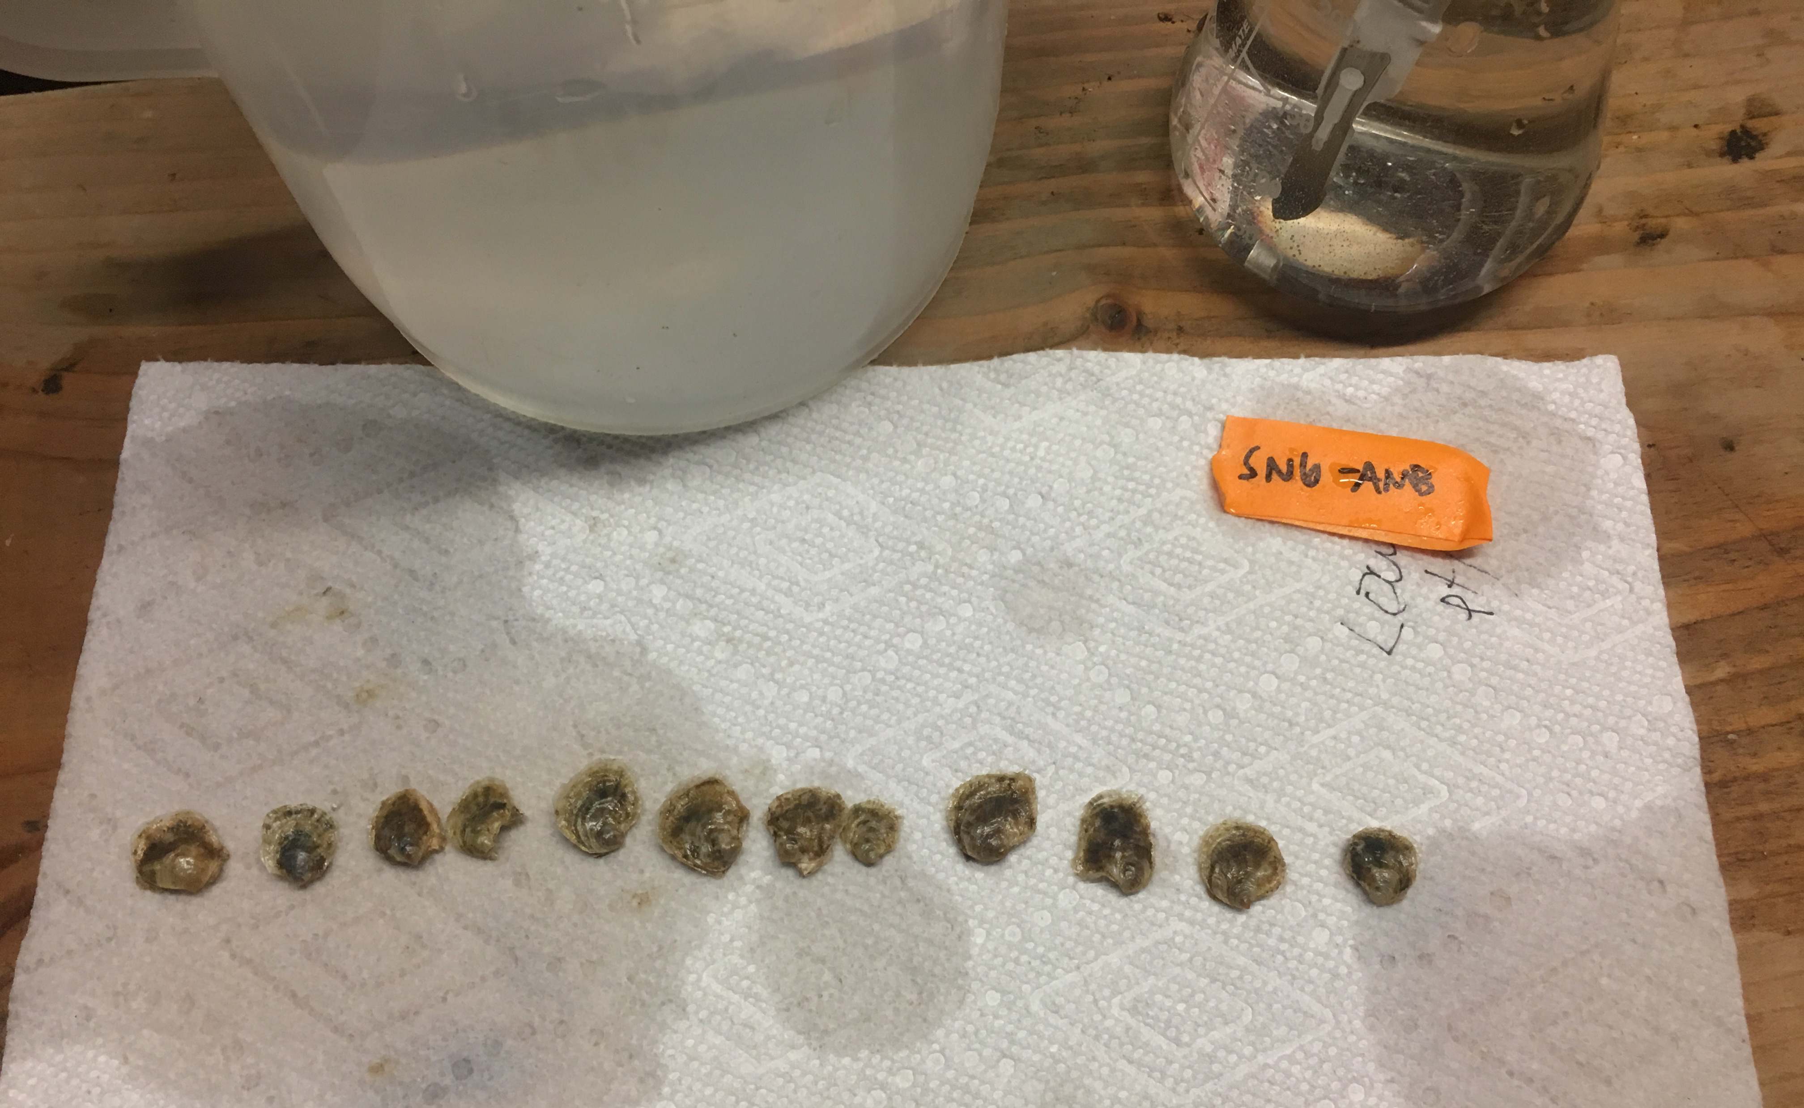
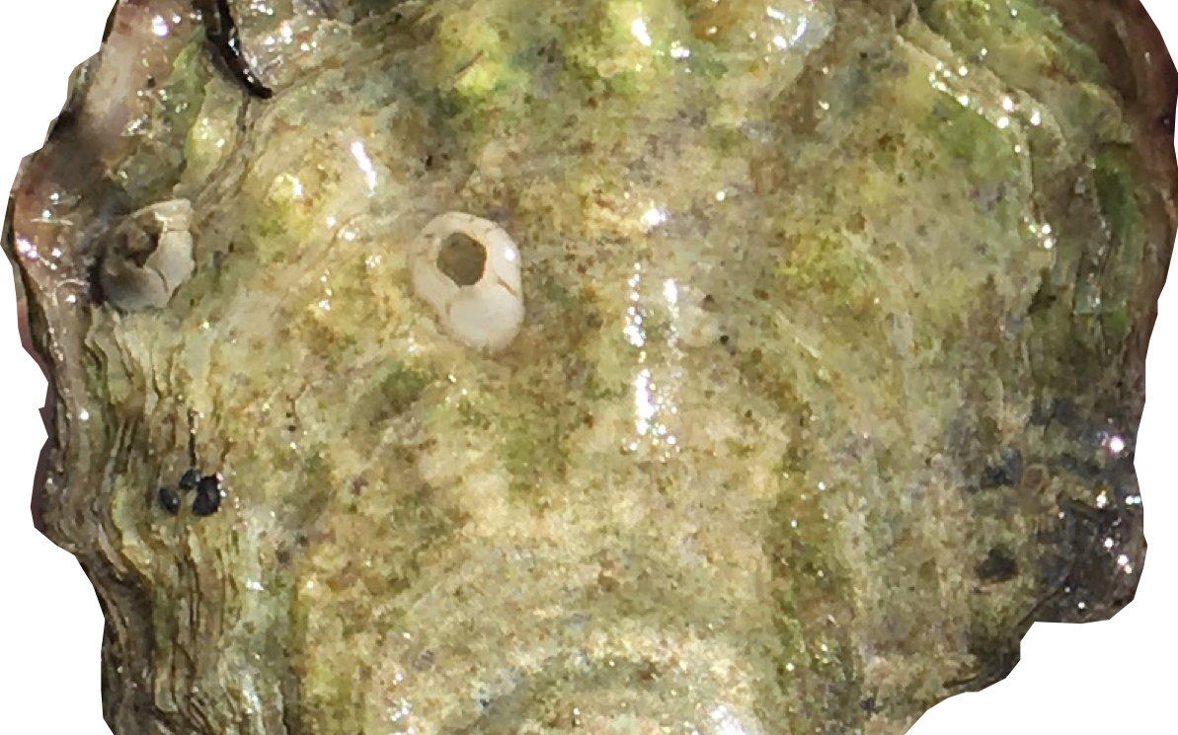
Physiological carryover effects of high pCO₂ exposure
QuantSeq 2020 project
Does/how does high pCO₂ exposure affect adult gill tissue gene expression?
Does parental low pH exposure affect offspring gene expression
~2wk-old larvae upon release
15month-old juveniles at end of field trial in Port Gamble Bay, WA
→ Important: offspring never exposed to different pCO₂ conditions

Slide 2
QuantSeq / TagSeq Library Prep

Slide 3
Goal: generate high quality gene expression data (RNASeq)
Isolate Total RNA
RNAzol RT, Turbo DNase
Raw data quality assessment:
FastQC & MultiQC
Clean Raw Data with Cutadapt
Trim Illumina adapters, poly-A & poly-G tails, filter for size
Cleaned data quality assessment:
FastQC & MultiQC
Sequence Libraries
NovaSeq single-read 100bp, 2 lanes each with pooled libraries (n=69 & 77)
Generate Libraries
Lexogen QuantSeq FWD Kit
QC & Quantify Libraries
Agilent HS DNA Chip & Bioanalyzer, Qubit HS DNA Assay
Adult ctenidia
After pCO₂ exposure
Larvae, whole body, pooled by “pulse”
Upon release from brood
Juvenile, whole body
~15month old, after 3-month field trial
My bioinformatics workflow
Part 1: Raw read processing

Slide 4
Goal: generate accurate gene count matrices
Option B:
Generate counts without aligning
Option A:
Align reads to genome & count reads/gene
Align with Bowtie2 or STAR
Generate counts per gene with featureCounts, genome feature files
Salmon in mapping-based mode with selective-alignment
Generate Salmon index from mega-transcriptome. Use genome to create list of “decoy” sequences
Generate counts per transcript with Salmon, decoy-aware mega-transcriptome index
Annotate mega-transcriptome (denovo, v3) via Blast & Unipot/Swisspot db
Summarize counts per gene via Tximport, annotated transcriptome
Generate Bowtie or STAR index from genome
My bioinformatics workflow
Part 2: translating reads to gene counts

Slide 5
Goal: Identify best read mapping method
I tested 8 of my 144 samples on three different read generation methods:
Alignment with STAR against Oly genome v081, annotate with GTF of exons with isoform information (from Stringtie)
Alignment with Bowtie against Oly genome v081; annotate with GFF of genes+2kb downstream
Selective alignment with Salmon against transcriptome v3 that is “decoy-aware” (decoy sequences from Oly genome); annotate by blastx with Uniprot db
SUMMARY of alignment methods | STAR | Bowtie | Salmon
Total no. input reads | 47,995,645 | 47,995,645 | 47,995,645
Average % uniquely mapped reads | 58.22 | 41.4 | NA
% Multi-mapped reads | 4.09 | 30.4 | NA
Overall alignment rate | 62.3% | 71.8% | 39.2%
# aligned reads | 30,145,597 | 33,937,733 | 19,818,281
# genes ID'd after filtering | 59,023 | 29,775 | 5,741
# counts in genes (after pre-screening) | 18,725,025 | 18,522,641 | 5,907,371
% counts in genes / total reads analyzed | 39.0% | 38.6% | 12.3%

Slide 6
Goal: Identify differentially expressed genes among parental treatments, cohorts
Sample quality check: Heat map, initial PCA, total counts
Differential gene expression with DESeq:
Compares log2-fold change for each gene between treatments (use untransformed counts)
Transform data for PCA & heat maps
(reduce variance / heteroskedasticity)
Can be done in DESeq
Assess sample clustering via PCA, heat maps w/ hierarchical
Generate gene count matrix
Bowtie2 →
Salmon → Tximport to get gene counts from transcript counts
Data screening; remove genes that …
- Don’t show up in any samples
- Have little variability between all samples (min CV=5)
- With total reads across all samples <10
My bioinformatics workflow
Part 3: Comparing gene expression among treatments

